Slide 1

MENTORNESS
Market Price Prediction
Time series Forecasting

Slide 2

CONTENTS
Background
Objective
Dataset overview
Data Preprocessing
Model Building-ARIMA&SARIMA
SARIMAX Model
Facebook Prophet Model
LSTM Model
Comparion of performance of models
Conclusion

Slide 3

Background
In the realm of market analysis and forecasting, understanding the intricate patterns within time series data is paramount for informed decision-making. With the advent of machine learning techniques, it's now possible to delve deeper into historical market data to predict future trends accurately. In this context, we have at our disposal a dataset containing monthly market data spanning multiple years, encompassing various regions, commodities, and pricing information.

Slide 4
Objective
The primary objective of this project is to develop a robust time series machine learning model capable of accurately forecasting market trends based on historical data.

Slide 5
Data Description
The dataset comprises the following columns:
market: The market or commodity under consideration.
month: The month for which the data is recorded.
year: The year corresponding to the recorded data.
quantity: The quantity of the commodity traded or available.
Price Min: The minimum price of the commodity during the month.
Price Max: The maximum price of the commodity during the month.
Price Mod: The mode or most frequently occurring price of the commodity during the month.
state: The state or region where the market is located.
city: The city where the market is situated.
date: The specific date of the recorded data.

Slide 6

Time Series Forecasting Models
Auto Regressive Integrated Moving Average (ARIMA)
Seasonal Auto Regressive Integrated Moving Average (SARIMA)
Seasonal Auto Regressive Integrated Moving Average with Exogenous Regressors(SARIMAX)
Facebook Prophet Model
Long Short Term Memory (LSTM Forecasting)

Slide 7
Key insights of this project
Importing the Libraries
Loading the Dataset
Data Preprocessing
Feature Engineering
Model Building
Model Training
Prediction
Evaluation

Slide 8
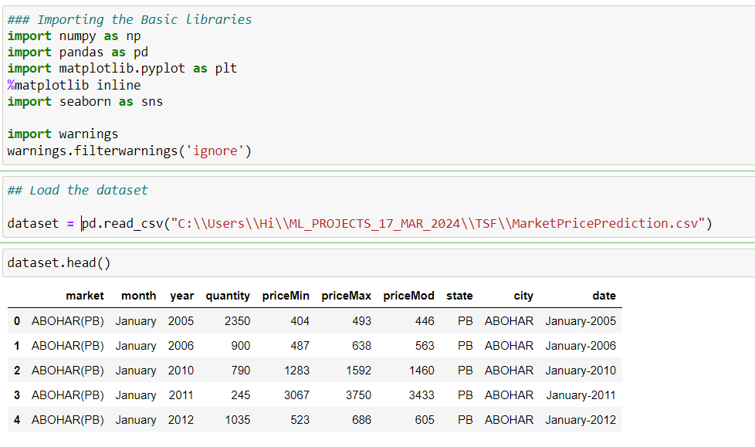
IMPORTING LIBRARIES AND LOADING THE DATA SET

Slide 9
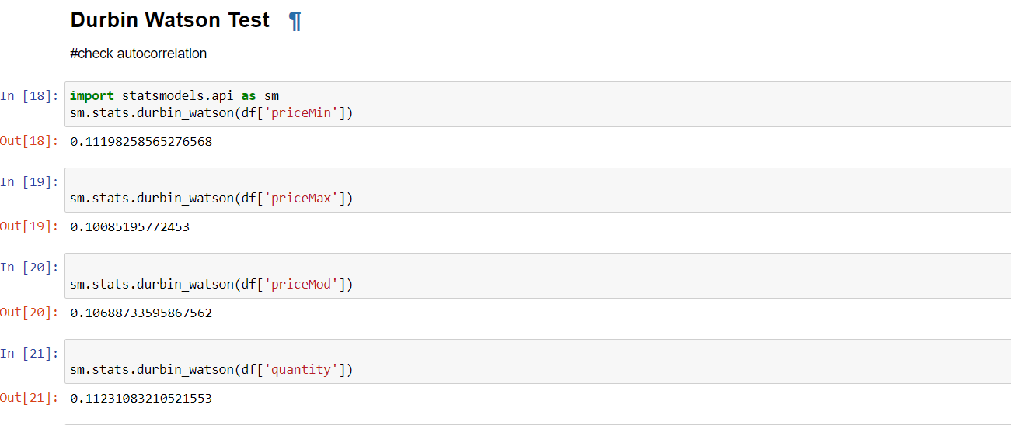
Durbin Watson test:
A test to detect autocorrelation in the residuals from a statistical model or regression analysis
Range between 0-4
2 means No auto correlation
Less than 2 –Positive Autocorrelation
More than 2 –Negative Autocorrelation

Slide 10
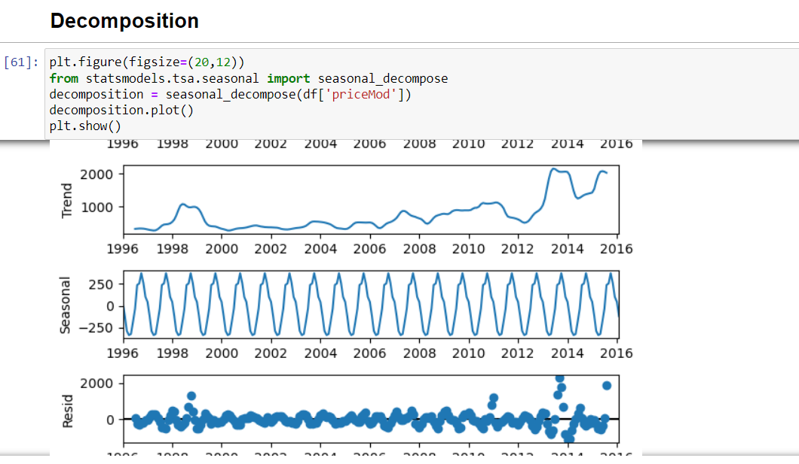

Slide 11
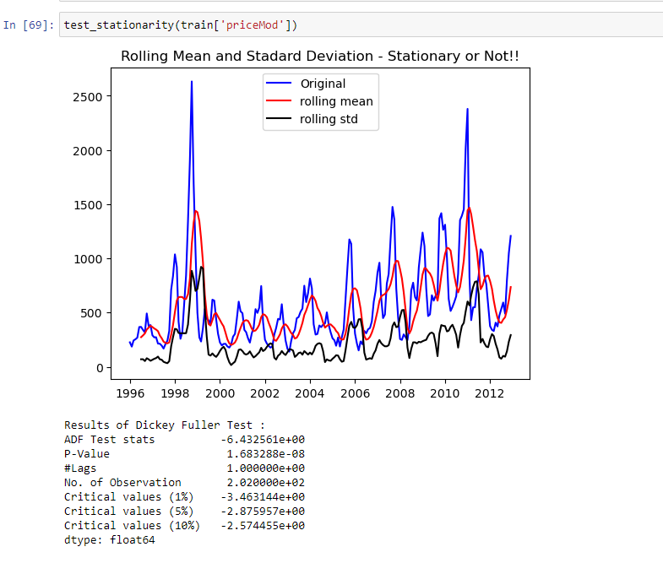

Slide 12
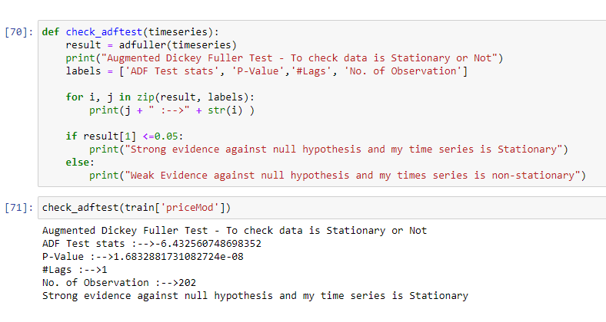
Augmented Dickey Fuller Test

Slide 13
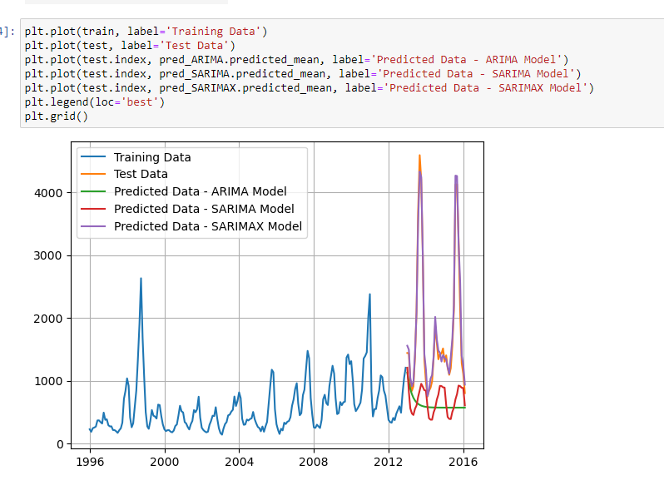
Forecasting of Various Models

Slide 14
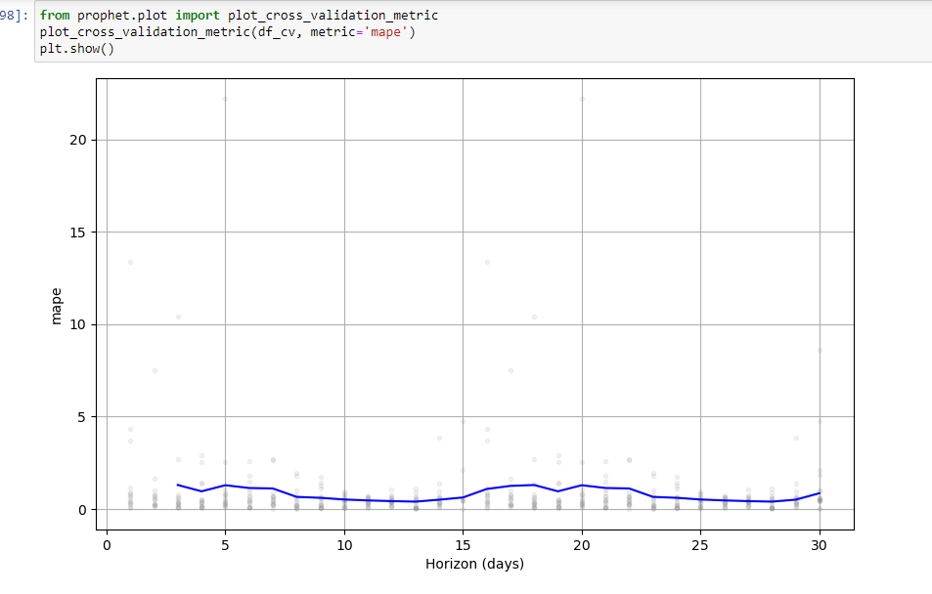
Facebook Prophet Model

Slide 15
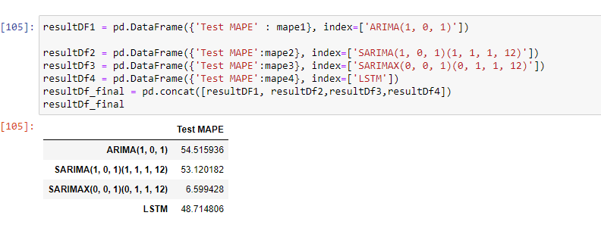
Model Evaluation

Slide 16

CONCLUSION
SARIMAX showing the better performance among all the Models.
Mean Absolute percentage Error (MAPE):6.59

